Slide 1


Slide 2





MEET THE TEAM
NASIR KHALID
ADIB ALI MOHAMMAD
MAHMOUD SAAD
PROJECT LEAD
SOFTWARE DEVELOPER
ALGORITHMS & PATH ANALYST

Slide 3



Challenges as a first responder
Time
The difference a minute can make…
Uncertainty
Impact of a decision

Slide 4
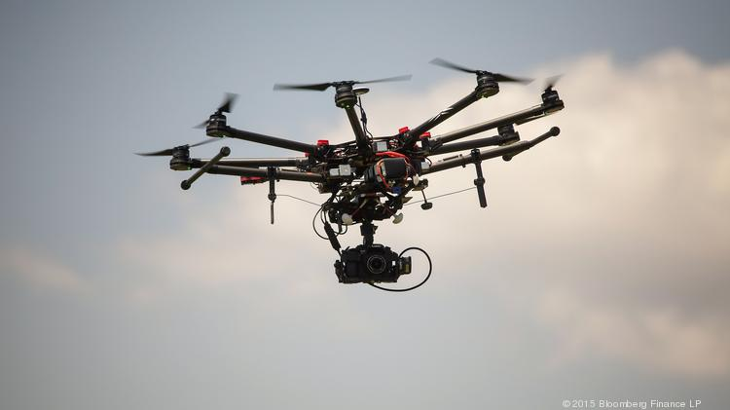
Using Drones to create the optimal path for First Responders

Slide 5



The process
Deploy
Scout
Path

Slide 6
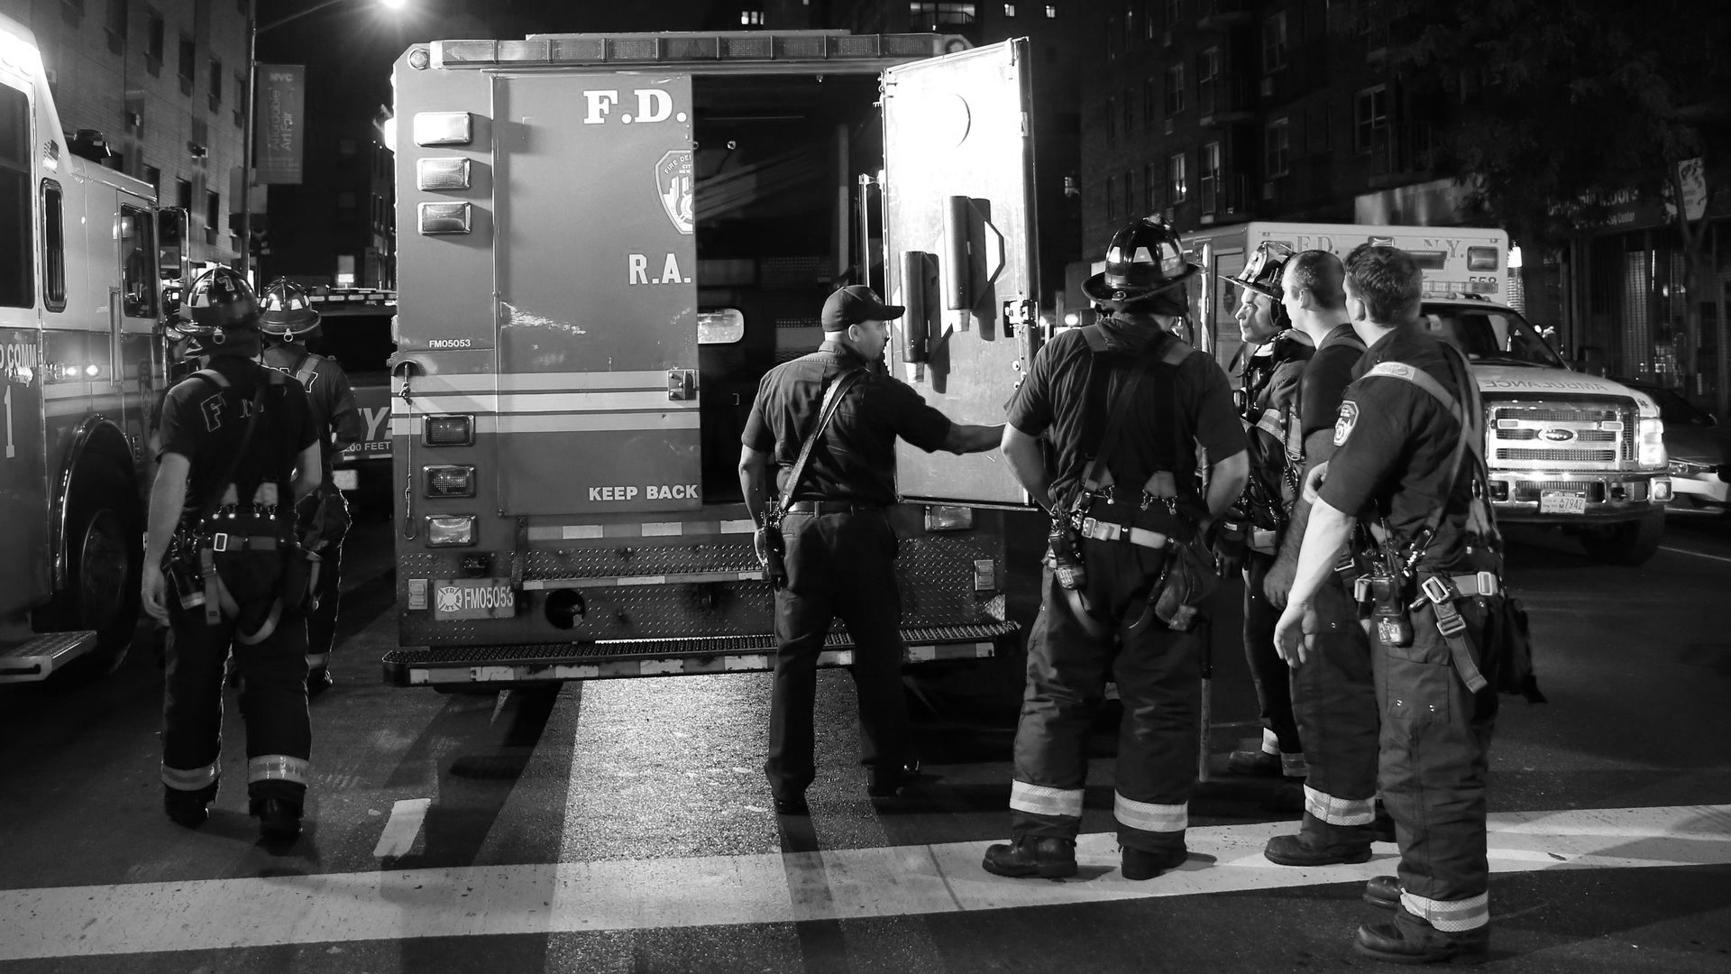
Let’s see how it works..

Slide 7




Governments & NGO’s
So how does this help?
First Responders
Victims of the disaster
Data monetization

Slide 8

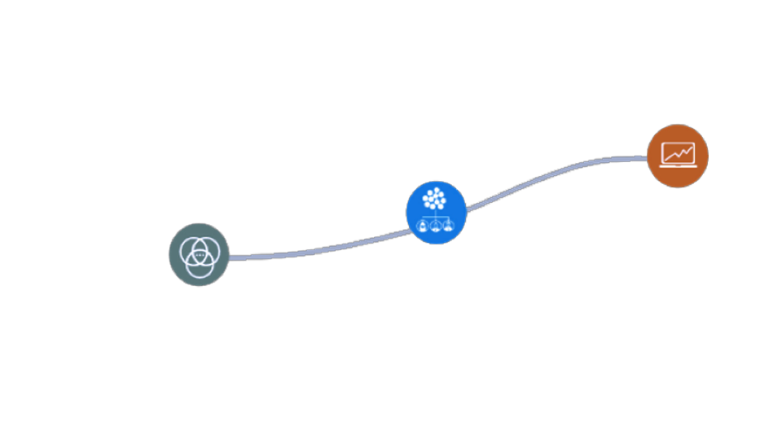
Data monetization
Revenue potential
Applied Data
Transformed Data
Enriched Data
Value to researchers
Analytics-enabled platform as a service

Slide 9

What’s next?

Slide 10
Thanks!
Reach out to us:
GitHub link: github.com/mabouamer/Pathfinder2019

Slide 11
Costs of removal of Obstacles
Tree
100
800
400
Water Range
400
8000
2000
Fire
500
6000
3000
Rocks
170 per m²

